Slide 1
Machine Level Programming
project 4
Yana Gabelev

Slide 2
Links
Project 4:
http://my.jce.ac.il/~arikgi/Web/Ex/Ex04/index.htm
EX04 zip :
http://my.jce.ac.il/~arikgi/Web/Ex/Ex04/Ex04.zip

Slide 3
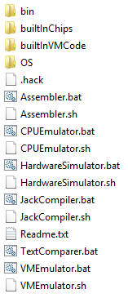
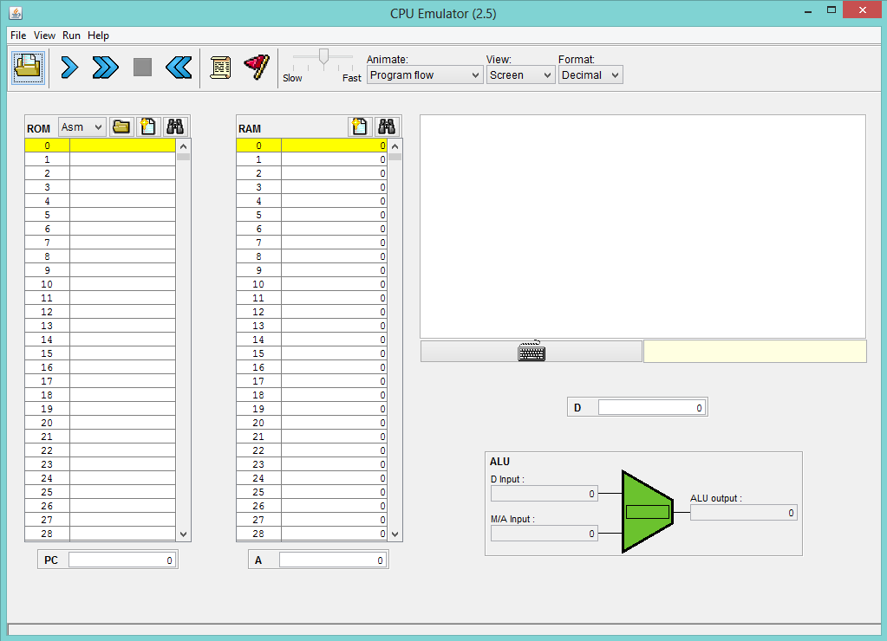

Slide 4
Hack Machine Language Specification
16-bit machine.
two separate memory modules, 32K 16-bit words each
Instruction memory (ROM)
Data memory (RAM)
two memory-mapped I/O devices
Black-and-white screen 256 rows of 512 pixels per row (8K memory map at RAM address 16384)
Keyboard (single-word memory map at RAM address 24576)
Notes:
גודל רגיסטר bit16, גודל כתובת bit15, גודל הזיכרון K32 (כל אחד)
מסך שחור-לבן (שחור=1, לבן=0) בגודל 512X256 פיקסלים => 256 שורות ו-32 רגיסטרים בכל שורה

Slide 5
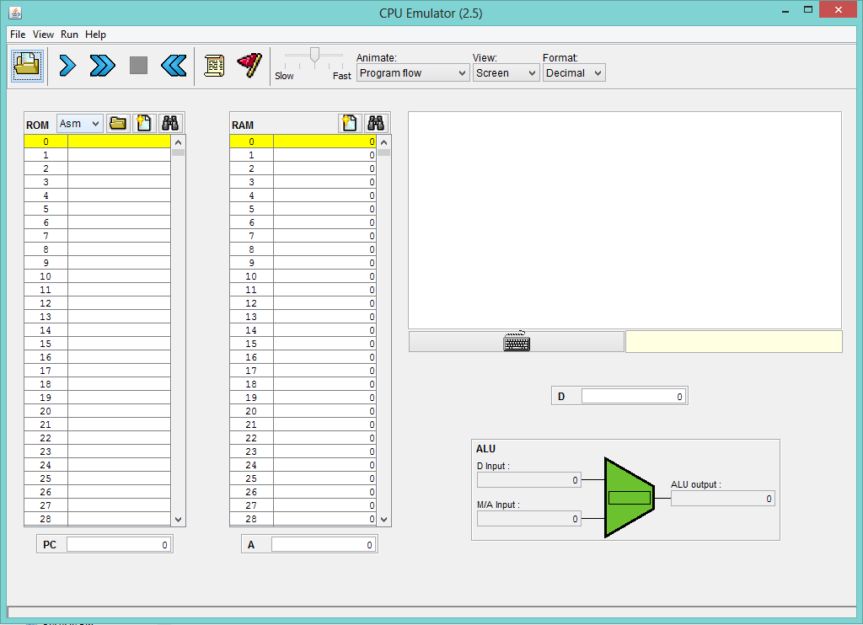
Speed
Screen
Instruction
memory
Data
memory
Keyboard
↓
ALU
↓
←Data register
↑
Program counter
↑
Address register

Slide 6
Registers
D, A, M: 16-bit general-purpose registers, manipulated explicitly by arithmetic and logical instructions
D is used solely to store data values
A doubles as both a data register and an address register
M register refers to the memory location addressed by A (M=Memory[A])

Slide 7
The A-Instruction
A-instruction: @value
This command simply stores the specified value in the A register
Where value is either a non-negative decimal number or a symbol referring to such number
Example:
if sum refers to memory location 17, then both “@17” and “@sum” will have the same effect: A←17
Notes:
יש מגבלה- לכן שפת HACK מתחלקת ל-2 פקודות: פקודת A ופקודת C
פקודת A - השמת ערך
פקודת C – חישוב שמירה וflow

Slide 8
The C-Instruction
C-instruction: dest = comp ; jump
Either the dest or jump fields may be empty. If dest is empty, the "=" is ommitted; If jump is empty the ";" is omitted
comp:
0,1,-1,D,A,!D,!A,-D,-A,D+1,A+1,D-1,A-1,D+A,D-A,A-D,D&A,D|A,
M, !M, -M, M+1, M-1,D+M,D-M,M-D,D&M,D|M
dest :
null,M,D,MD,A,AM,AD,AMD
jump :
null,JGT,JEQ,JGE,JLT,JNE,JLE,JMP
Notes:
עושים או comp או jmp. אף פעם לא שניהם – אם עשינוcomp משמיטים ';jmp' אם עשינוjmp משמיטים '=comp'

Slide 9
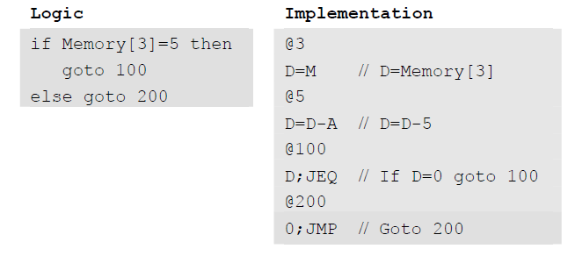
The C-Instruction
Example:

Slide 10
Symbols
Predefined symbols :
Virtual registers: R0 to R15 are pre-defined to refer to RAM addresses 0 to 15.
I/O Pointers: SCREEN and KBD are pre-defined to refer to RAM addresses 16384 and 24576.
Label symbols: Label destinations of goto commands. Declared by “(Xxx)” .
Variable symbols: Symbol Xxx appearing in an assembly program that is not predefined and is not defined elsewhere label command is treated as a variable, starting at RAM 16.
Notes:
בROM יש לייבלים בRAM יש משתנים –אותו רעיון פשוט כותבים שם (משתנים בlower case- ולייבלים בupper case-)
המחשב נותן להם ערך לבד – אם זה משתנה הוא נותן כתובת בזיכרון, אם זה לייבל הוא נותן לו את כתובת הפקודה הבאה
לייבלים הם לא שורות קוד באמת – רק סימון שורה – לכן לא נראה אותם באסמבלר

Slide 11
Ex. 1
(LOOP) //while(true)
@KBD //if(KBD=0)
D=M
@NO_KEY_PRESSED
D;JEQ
@KEY_PRESSED
0;JMP
(KEY_PRESSED) //else
@11 //RAM[0]=11;
D=A
@R0
M=D
@AFTER_COND //}
0; JMP
(AFTER_COND)
@LOOP //}
0; JMP
(NO_KEY_PRESSED)
@10 //RAM[0]=10;
D=A
@R0
M=D
@AFTER_COND //}
0; JMP
Translate to HACK:
while(true) {
if(KBD=0) {
RAM[0]=10;
}
else { RAM[0]=11;
}
}

Slide 12
Ex. 2
@25
D=A
@R0
M=D @INFINITE_LOOP
D;JLE
@counter
M=D
@SCREEN
D=A
@addr
M=D
(LOOP)
@addr
A=M
M=-1
@addr
D=M
@32
D=D+A
@addr
M=D
@counter
MD=M-1
@LOOP
D;JGT
(INFINITE_LOOP)
@INFINITE_LOOP
0; JMP
When key pressed:
Draw a rectangle at the top left corner.
Otherwise:
Clear screen.

Slide 13
How and what to submit
Create a folder named 2015B_exXX_YYYYYYYY, when XX is the ex number, and YYYYYYYY is your ID.
For example: 2015B_ex04_123456789
All submission files should be in that folder, and no other extra file. Files to submit: .asm files, README.txt
Zip the folder to a zip file named 2015B_exXX_YYYYYYYY.zip

